Slide 1
SAMPLING DISTRIBUTIONS AND THE CENTRAL LIMIT THEOREM

Slide 2


Slide 3
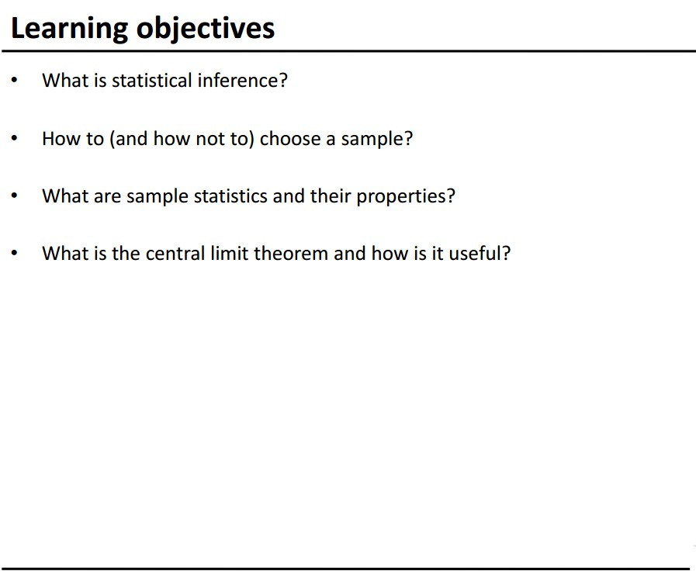

Slide 4
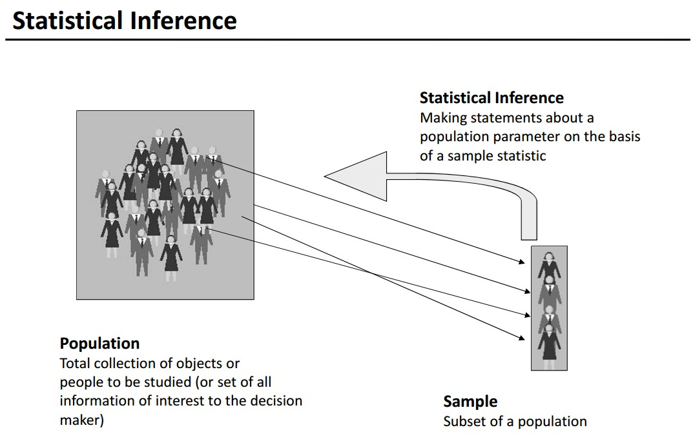

Slide 5
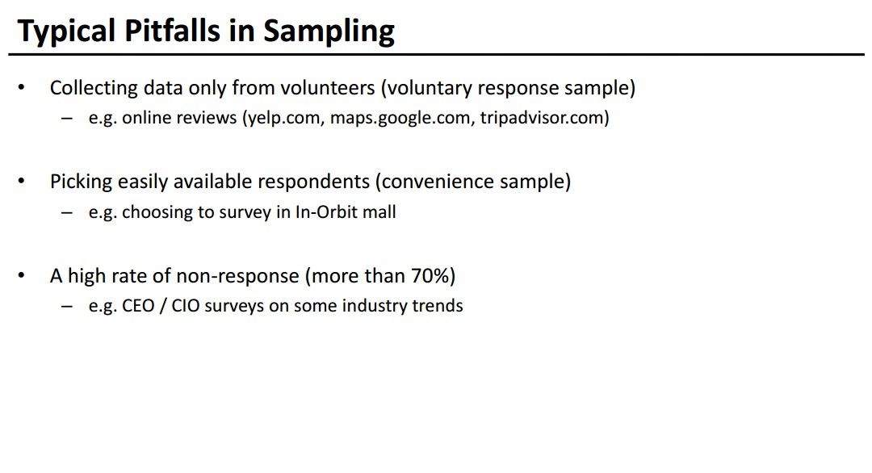

Slide 6
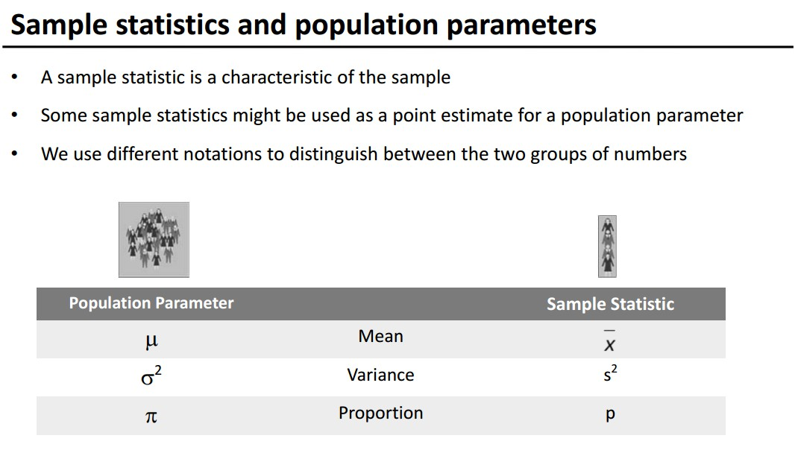

Slide 7
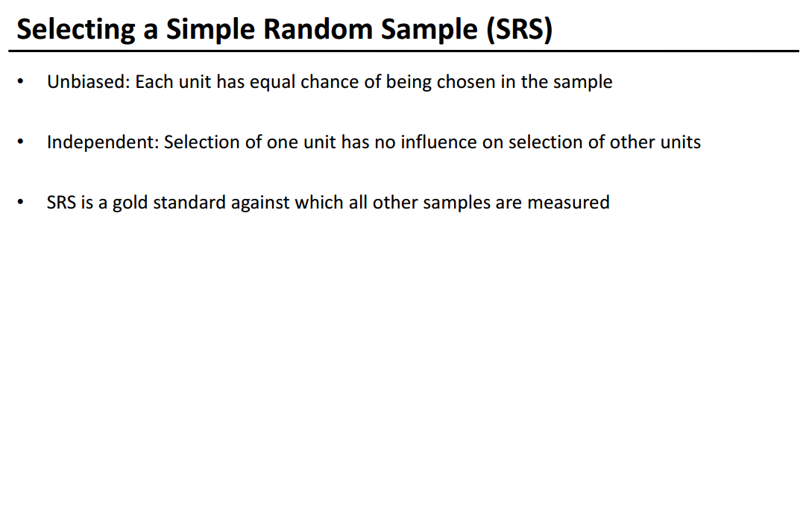
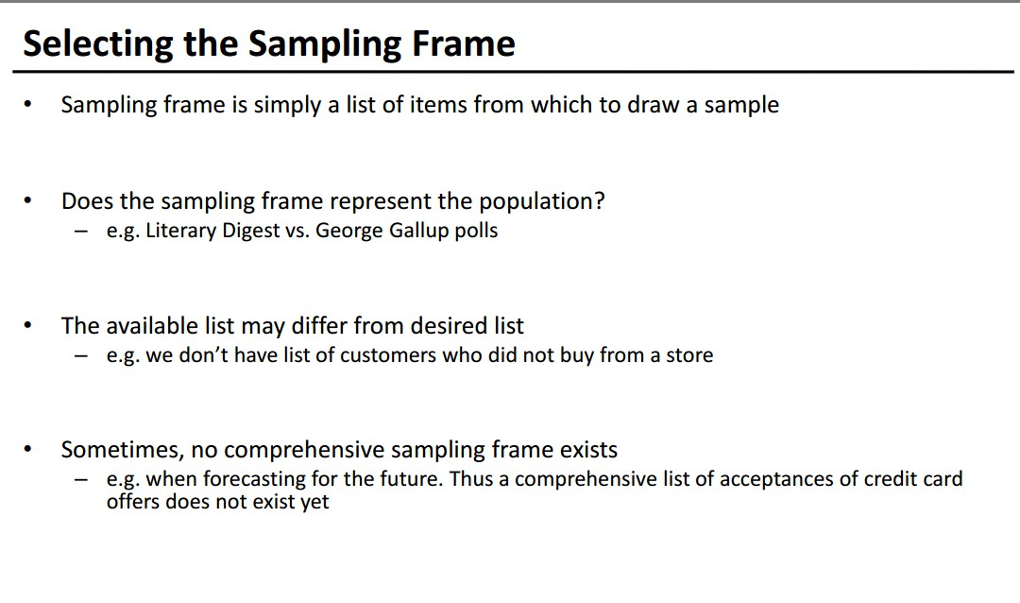

Slide 8
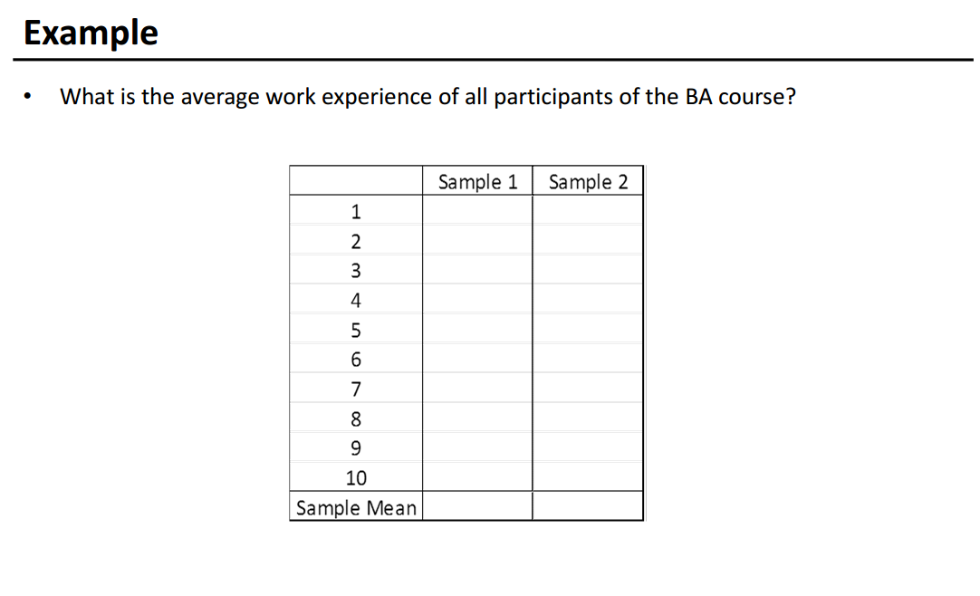

Slide 9
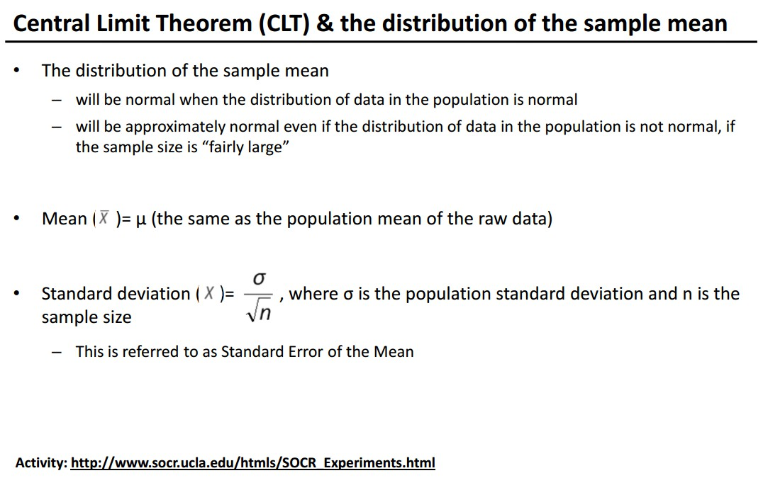

Slide 10
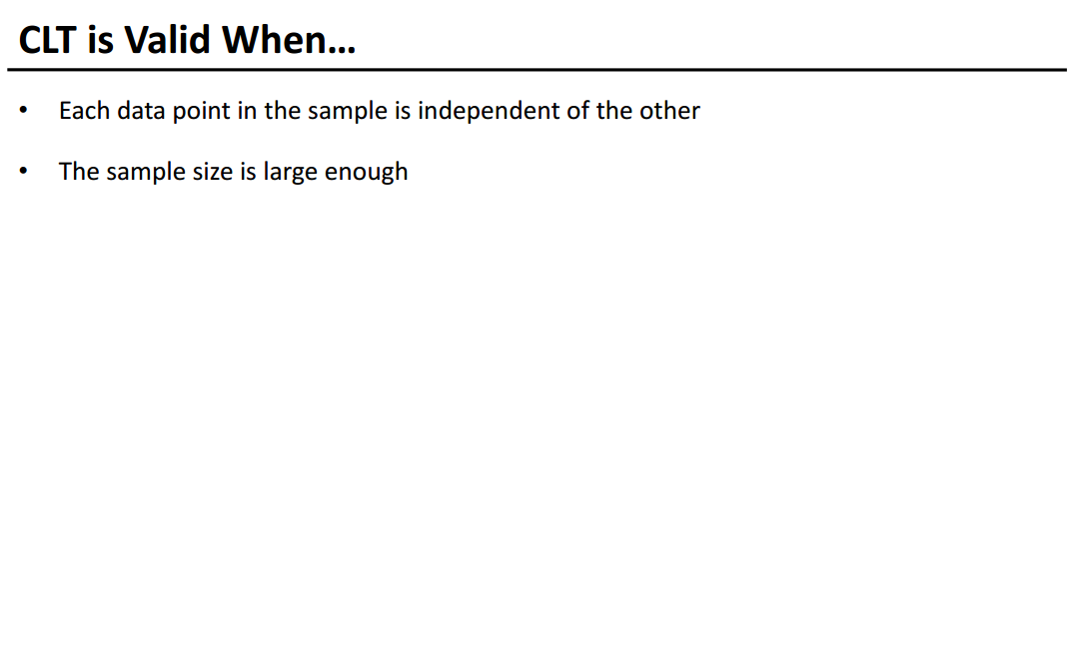

Slide 11
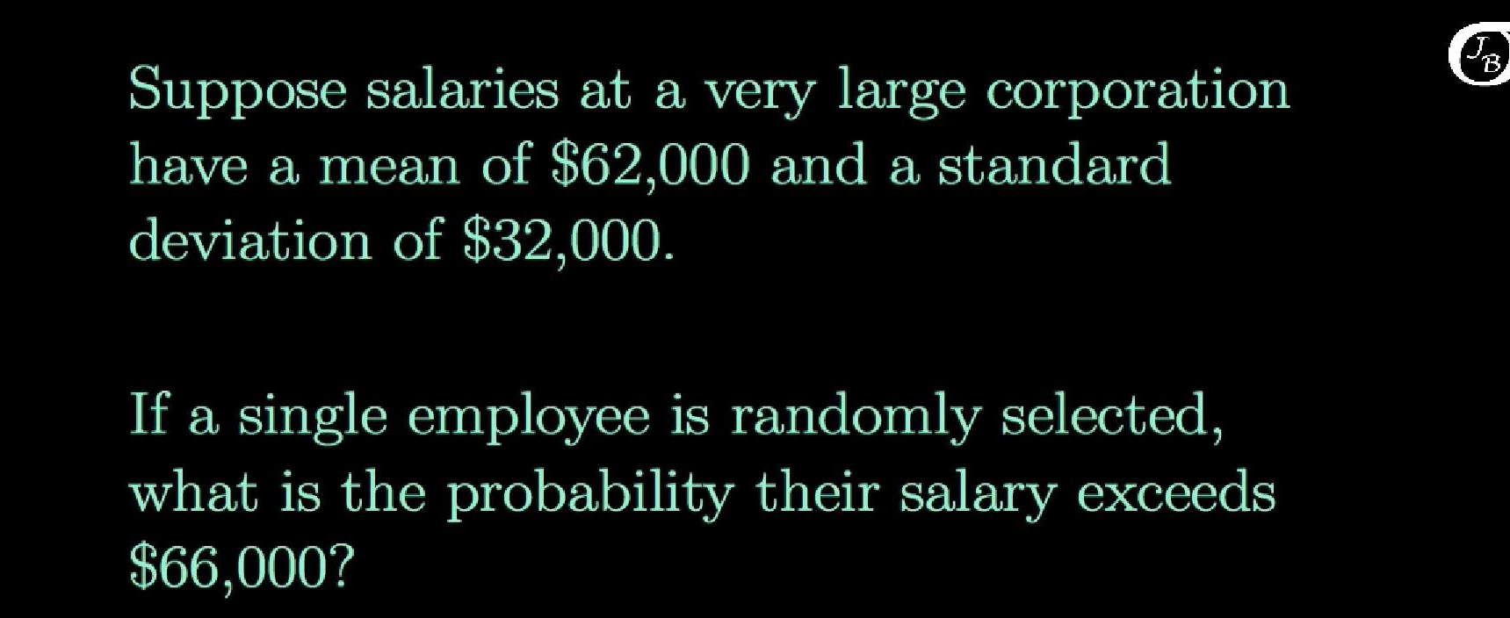
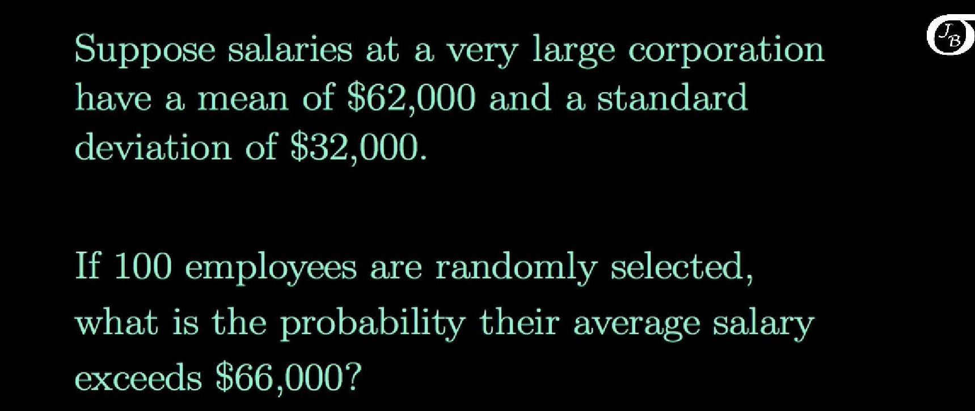

Slide 12
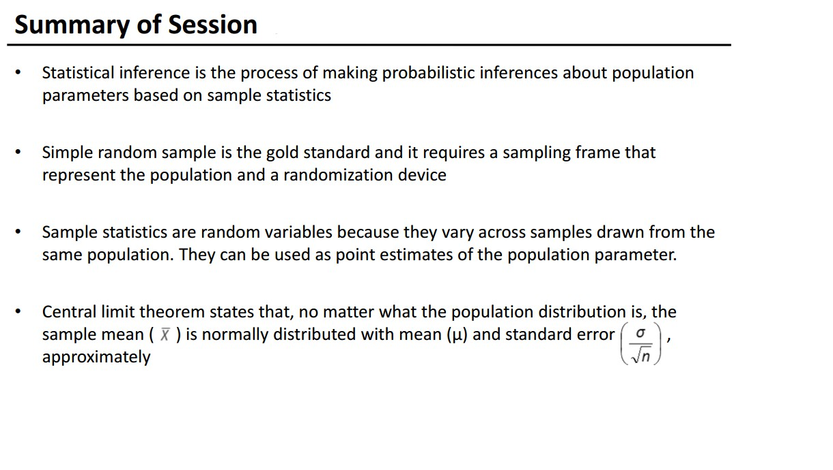
Example and Resource material:
T-table sample link : http://www.itl.nist.gov/div898/handbook/eda/section3/eda3672.htm
Refer page 24:https://www.saylor.org/site/wp-content/uploads/2012/03/Introductory-Business-Statistics.pdf

